Slide 1
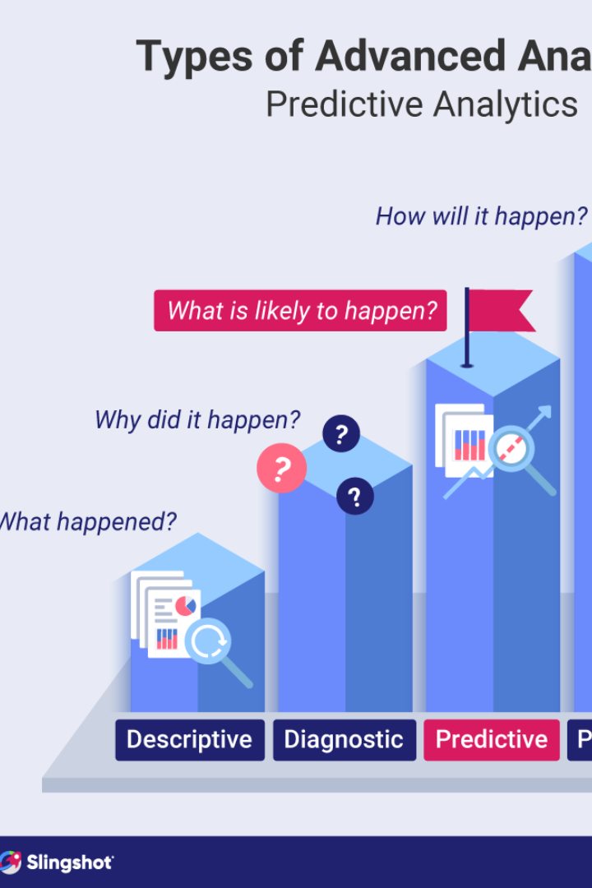
Customer Churn Prediction
Customer churn prediction is the process of identifying customers who are likely to leave a business. Understanding the reasons behind customer churn can lead to smarter business decisions.

Slide 2

Topics Covered in this Presentation:
Introduction
Jupyter Notebook Interface
Data Extraction with Jupyter Notebook
Using Machine Learning Algorithms
Conclusion

Slide 3
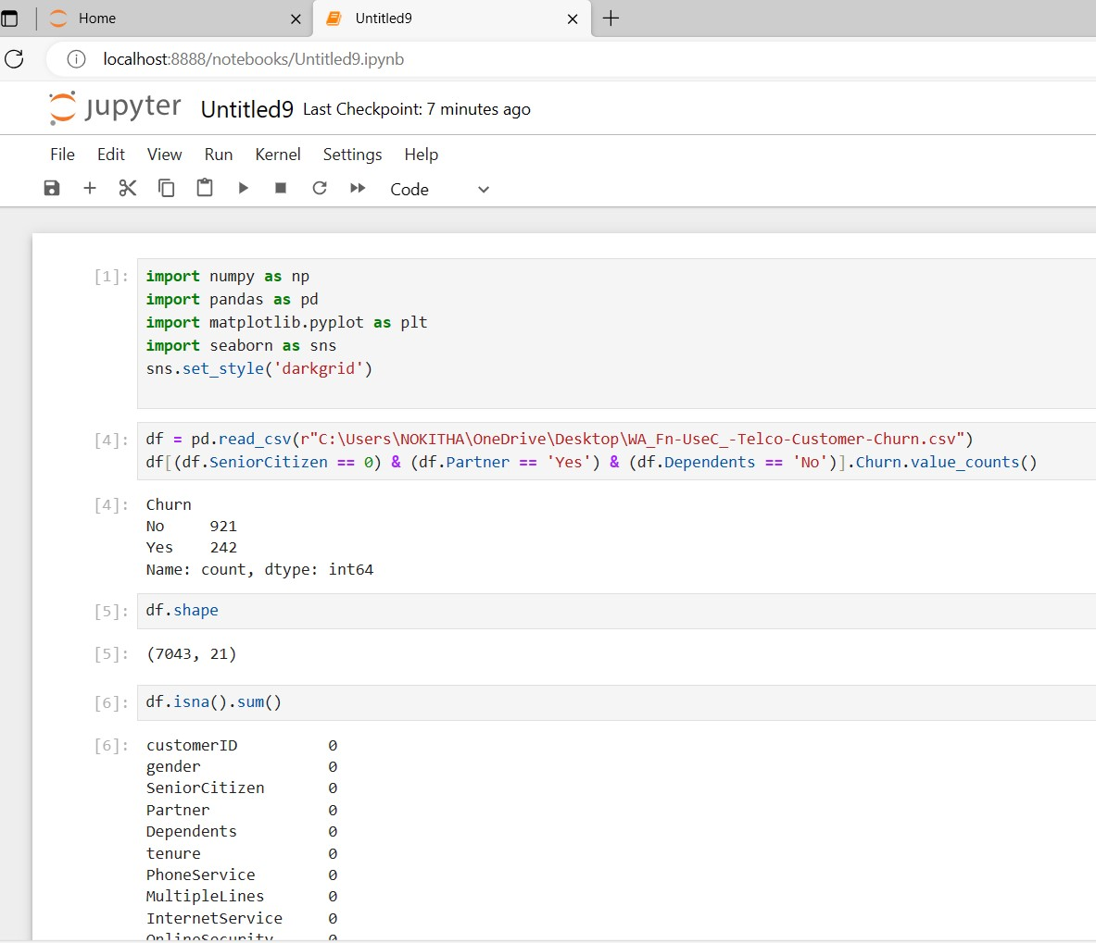
Introduction:
NumPy
NumPy, which stands for "Numerical Python," provides
support for working with large, multi-dimensional arrays
and matrices, along with a collection of mathematical functions to operate on these arrays efficiently. NumPy is a core library in the Python data.
Data Loading :
Data Loading is defined as copying data from one electronic file or database into another.
Data loading implies converting from one format into another
Data Preparation :
Data preparation is the process of preparing raw data so that it is suitable for further
processing and analysis.
Data Exploration:
NumPy calculates statistics, revealing insights into transportation data.
Numerical Operations:
Efficient element-wise operations, aggregations, and calculations are
easily performed.

Slide 4
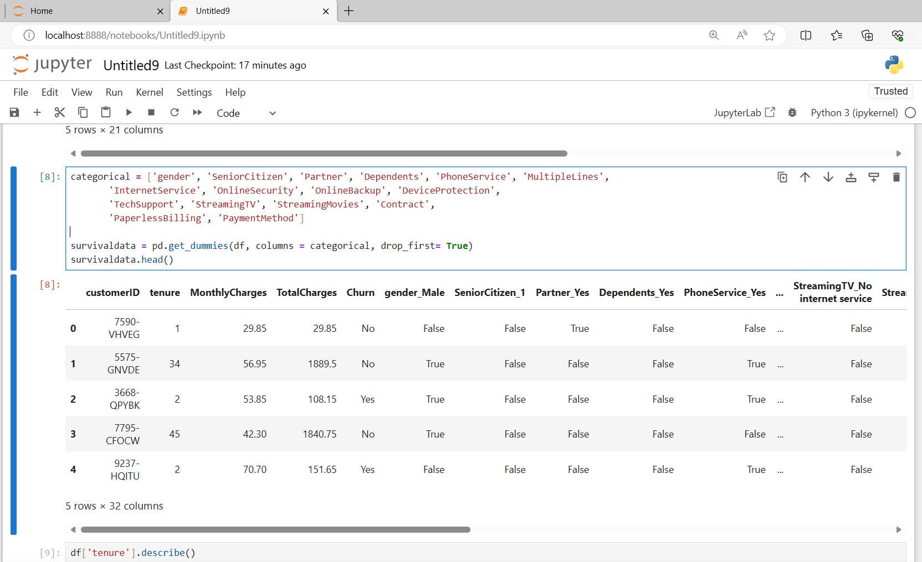
Pandas DataFrame
A pandas DataFrame is a two-dimensional, labelled data structure commonly used in data analysis and manipulation within the Python programming language. It is one of the fundamental data structures provided by the pandas library.
Data Import:
Pandas reads transportation datasets from various formats such
as CSV, Excel, SQL databases, or web sources, into
DataFrame structures.
Data Exploration:
Pandas provides tools for exploring and summarizing data,
including methods for checking basic statistics, identifying
missing values, and understanding data distributions.
Data Manipulation:
Pandas filters, selects, merges, and reshapes data efficiently.
Time Series Analysis:
:Supports analysis of time-related trends in transportation data.

Slide 5
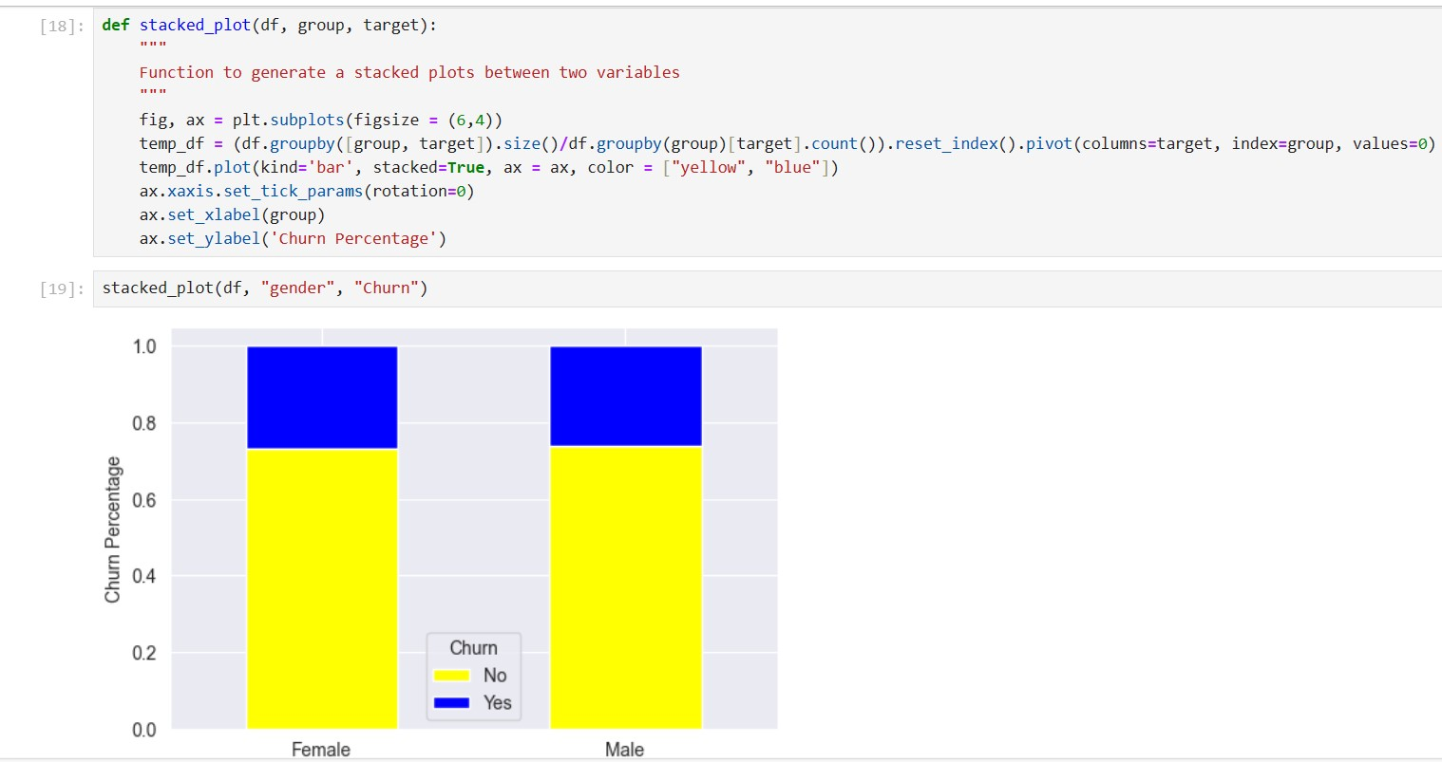
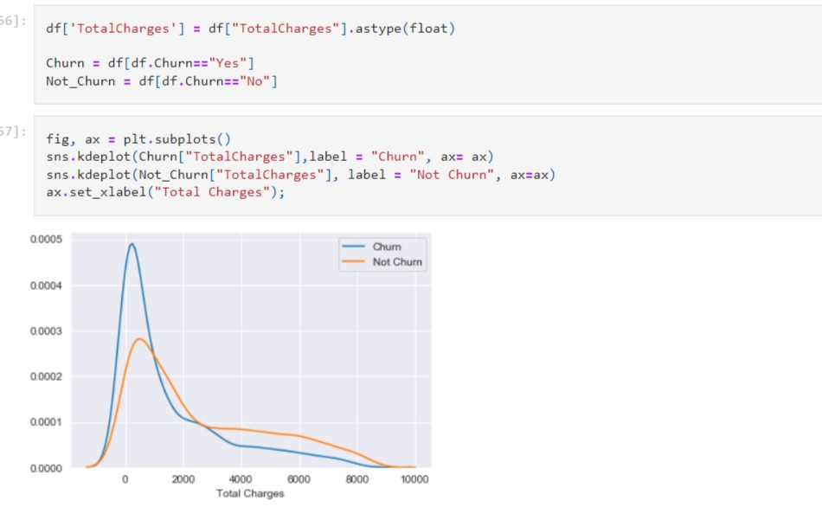
Matplotlib
Matplotlib is a widely-used Python library for
creating static and interactive visualizations and plots.
It is a powerful tool for data visualization and is
particularly popular in the fields of data analysis,
scientific computing, and machine learning.
Data Visualization:
Matplotlib creates diverse transportation data
visualizations.
Exploratory Data Analysis(EDA):
Helps explore data, find trends, and detect outliers.
Performance Metrics:
Visualizes traffic patterns and efficiency metrics.
Customization and Interactivity:
Offers flexibility and interactivity for effective data representation.

Slide 6
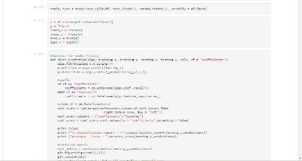
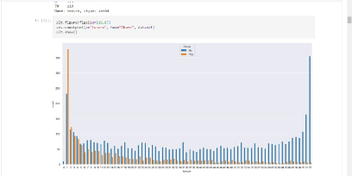
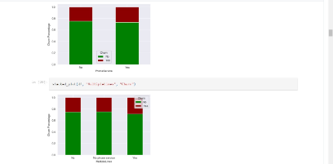
Jupyter Notebook Interface
Machine Learning Algorithms in Jupyter Notebook
Showcasing the implementation of KNN, CNN, and Gradient Descent algorithms in Jupyter Notebook.
Executing Code in Jupyter Notebook
Witness the step-by-step execution of code snippets within the Jupyter Notebook environment.
Visualizing Data in Jupyter Notebook
Demonstrating the power of data visualization using Jupyter Notebook's interactive capabilities.

Slide 7
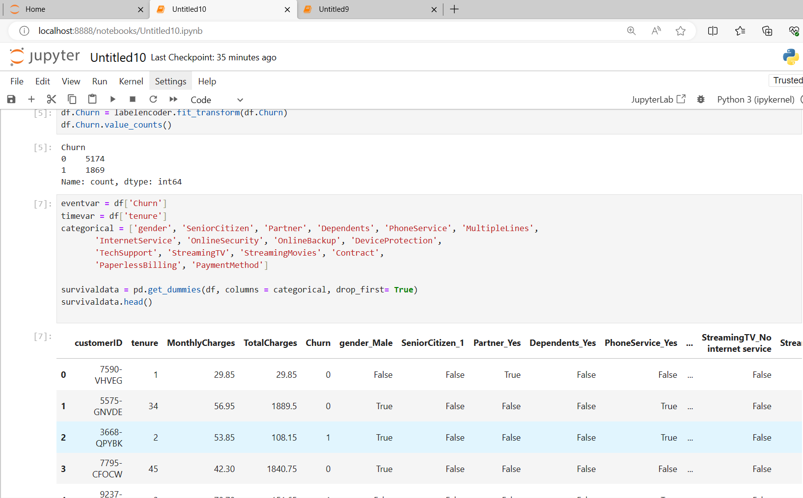
Data Extraction with Jupyter Notebook
Jupyter Notebook is widely used to extract data due to its
high flexibility and user-friendly interface. For this project,
we utilized Jupyter notebook to extract data from CSV files.
Specifically, we extracted data from two files:
20140711.csv and output_geo.csv. By leveraging Anacondas,
a popular distribution of Python, we were able to efficiently
extract and manipulate the data

Slide 8
Continuous Model Monitoring and Retraining
Building a Robust Data Pipeline
Continuous Model Monitoring
Continuous Model Retraining
Data pipelines should be designed so that they can quickly adapt to changes in data sources and model updates.
Models should be monitored regularly to ensure that they continue to perform well and produce accurate predictions.
Models should be retrained with updated data and adjusted algorithms to ensure that they remain effective at predicting customer churn.

Slide 9
Using Machine Learning Algorithms
KNN, CNN, and Gradient Descent are some of the most popular machine learning algorithms used for data analysis. In this section, we will discuss how these algorithms are useful to transportation efficiency data's analysis and their results.
KNN can help in real-time traffic management and route optimization, CNN can provide automated insights from visual data for better traffic monitoring, and Gradient Descent plays a crucial role in training predictive models for various transportation-related applications.
The results of these algorithms can lead to more efficient transportation systems, reduced congestion, lower costs, and improved overall transportation experiences.

Slide 10
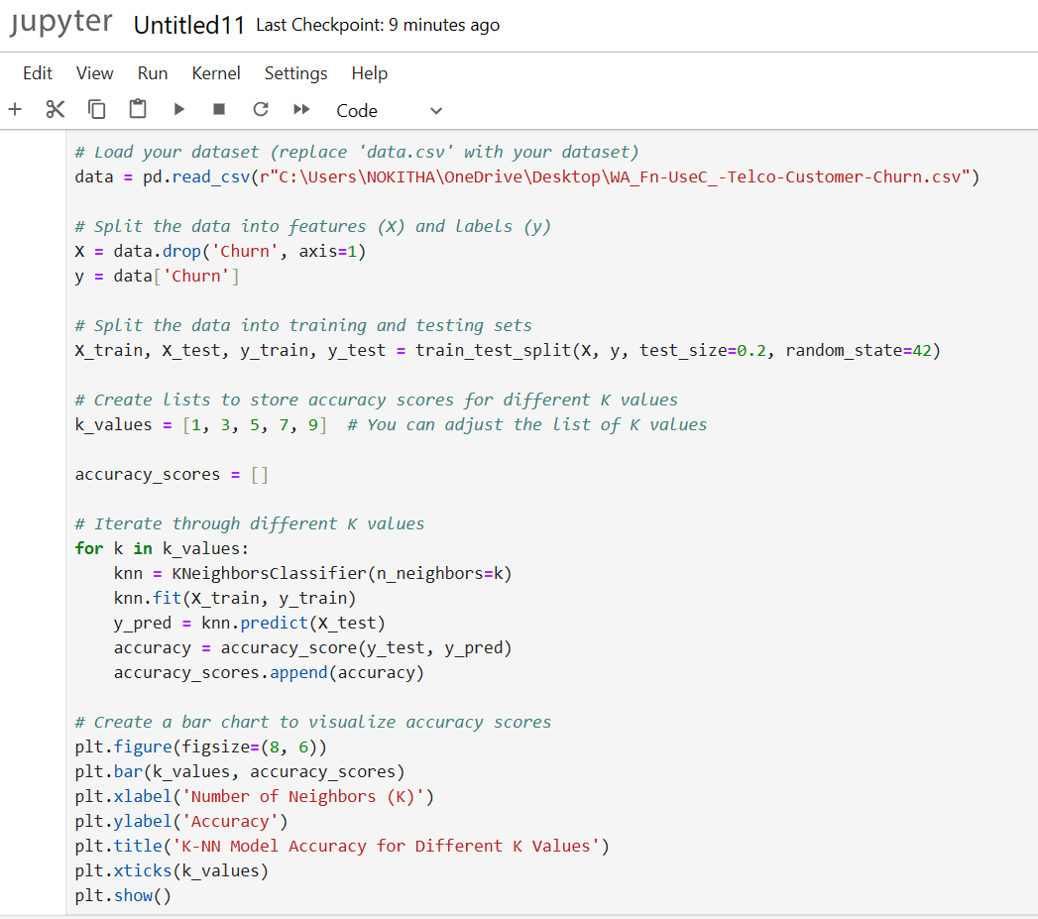
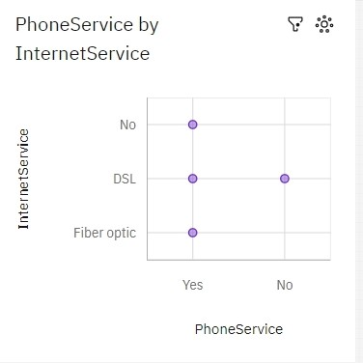
K-Nearest Neighbors (KNN) Algorithm
K-Nearest Neighbours (KNN) is a machine learning algorithm that classifies or predicts based on the majority class or average value of its 'k' nearest data points in a feature space, where 'k' is a user-defined parameter. Our team members implemented the KNN algorithm using Jupyter Notebook. The following screenshot depicts real-time implementation of the algorithm.

Slide 11
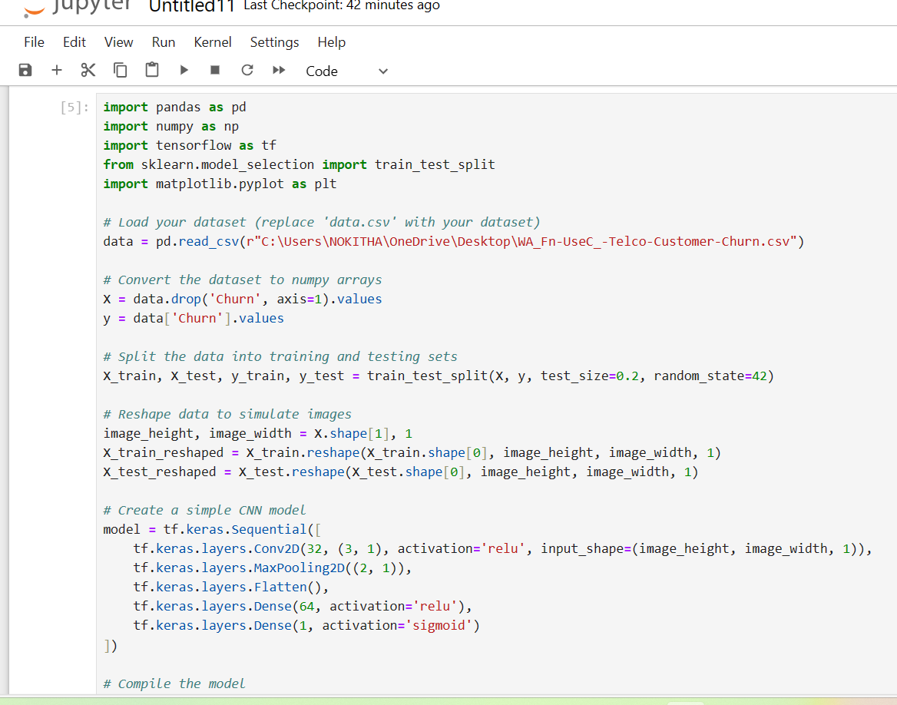
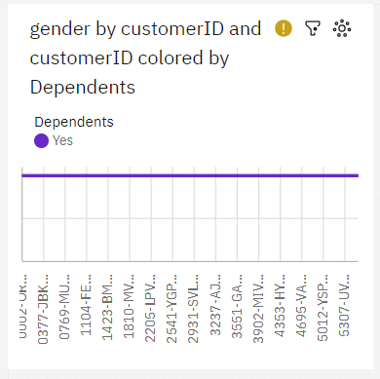
Convolutional Neural Networks (CNN)
A Convolutional Neural Network (CNN) is a deep learning algorithm designed for image and spatial data processing. It uses specialized layers to automatically learn and detect features in data, making it particularly effective for tasks like image classification and object recognition. CNNs are inspired by the human visual system and employ convolutional layers to extract hierarchical patterns and information from input data. You can see the execution of the CNN model in Jupyter Notebook in the following screenshot.

Slide 12
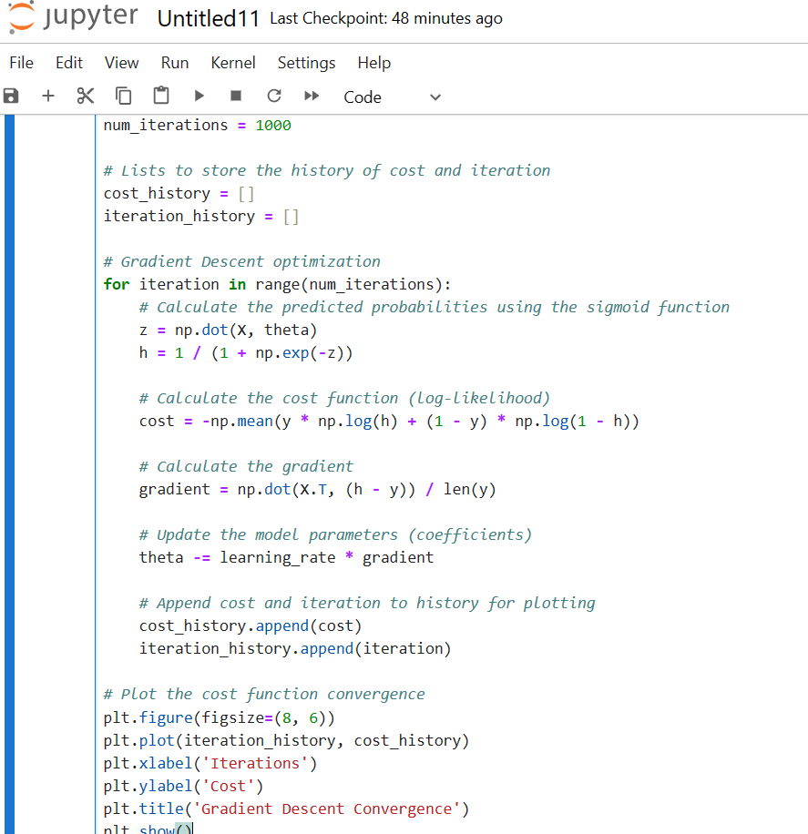
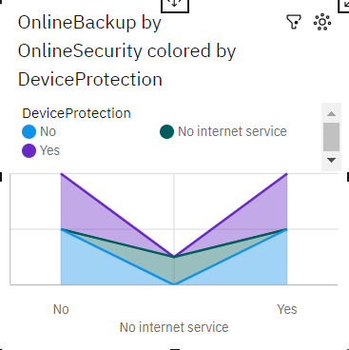
Gradient Descent Algorithm
Gradient Descent is an optimization algorithm used in machine learning to minimize the error or loss of a model. It iteratively adjusts model parameters in the direction of steepest descent (negative gradient) to find the minimum of a cost function. This process continues until it converges to an optimal set of parameters, improving the model's performance. You can see the Gradient Descent code and output in the following screenshot of Jupyter Notebook.

Slide 13
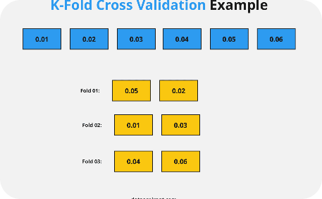
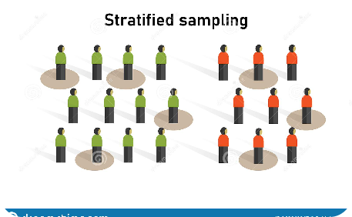
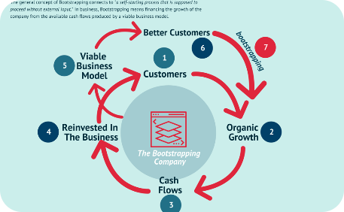
K-Fold Cross-Validation
Stratified Sampling
Bootstrapping
The data is divided into K equally sized folds. K-1 folds are used for training, and the remaining fold is used for testing. This process is repeated K times, with each fold being used once for testing.
The data is divided into strata (subsets) based on a specific variable. Data is then randomly sampled from each stratum to create a representative test dataset.
A resampling technique where samples are drawn from the data with replacement. This is useful for estimating the variability of a model's performance.

Slide 14
Conclusion:
1
Customer Churn Prediction is Critical
For businesses to retain customers, it's important to use data-driven techniques such as machine learning to predict and prevent customer churn.
2
Robust Techniques are Important
To ensure that your customer churn prediction models are effective, it's important to use best practices such as robust data pipelines, continuous monitoring and retraining, and cross-validation techniques.

